Slide 1
An Introduction to Programming

Slide 2
Welcome!
My name is Jacob Pawlak
I’m a third year Computer Science and Linguistics student
Programming is my job in the College of Health Science
I am here to help you learn how to write code, and make your own programs

Slide 3
Some fun reasons to code
Game Design
Software Engineering (Ultra lucrative $$$)
Robotics
Apple and Facebook and Google (oh my!)
The best jobs in this age, and you will be wanted by most every company

Slide 4
Before we talk about code...
Let’s talk about why code is important
It is an easy way to think about and solve problems
It will help you break down and understand large problems in order to solve them efficiently
It can make repetitive tasks easier
You can use it to help with homework
You will become better at math

Slide 5
Let’s start with the basics
We are going to be using the Python computer language because of it’s simple syntax and value for everyday programming. It is a great starting language and it’s really easy to learn.
Programming languages build programs, like games and the internet, for the computer to run. Anyone can build programs for the computer if the have a few tools.
The first tool you need is called an IDE - Integrated Development Environment

Slide 6
The IDE
Integrated Development Environments make programming easier by letting you see the program while you write it. Some, like the one we are using, allow you to build your code and run it. If the code has an error in it, the IDE will tell you the reason your code does not work. There are many IDEs out there, but the one we will use for this lab is called IDLE. It looks very plain, but it is very easy to use.
IDLE is made specifically for Python programming. You can download Python on any computer and program whenever you want.
We will see some pictures of IDLE on the next few slides while we talk about the Python language.

Slide 7
Python - Syntax and Structure
One of the fundamental things to know about Python is that the spacing and structure matter for the program to work.
All Python programs need to start with a definition
You can leave comments in the code that the IDE does not read, it’s best to leave notes for yourself and for others who look at your program
Spacing is important for Python, each ‘block’ of code must be indented in order to work. This also helps to visualize the structure of your program.

Slide 8
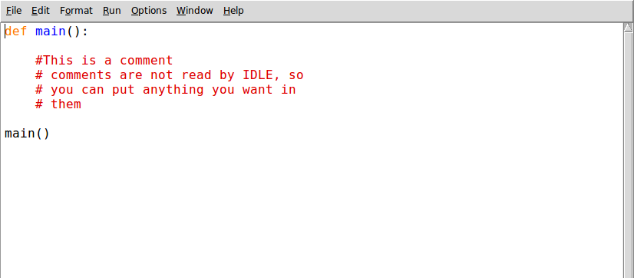
Python Syntax - Definitions

Slide 9
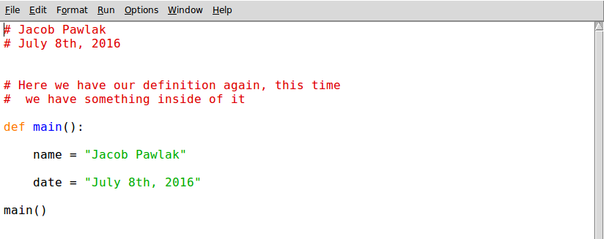
Python Syntax - Variables

Slide 10
Variables
Variables hold values for the code to use while running the program. There are a few different types of variables, namely strings, integers, booleans, and

Slide 11
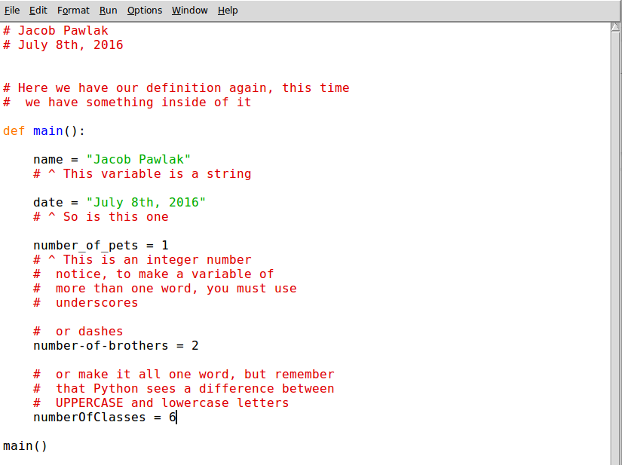
Python Syntax - Variables

Slide 12
Pseudocode (What is it..?)
Before we type any code, we want to make an outline of our project.
Think of it as an essay for solving a problem - you want to start by outlining (pseudocode) your essay and then filling it in according to your outline (actual code)
You can write down your pseudocode on paper, on a whiteboard, or as comments in your code.

Slide 13
An example
#Start with the definition
def main():
#Print your first name
print(“Jacob”)
#print your last name
print(“Pawlak”)
main()

Slide 14
Let’s code
Today we are going to start with a very easy program called HelloWorld
The idea is first we want to have the computer print out the words:
“Hello World!”
After we complete this we can have the computer print anything we want (your name, a cool catch phrase, your favorite food..)
We can walk through the pseudocode together
Let’s go!

